Slide 1
Chad
Team WareWolves
♚
A Simple and Elegant game of Tactical and Strategic depth
♔
Ben Goodwin, Joshua Munoz, Josiah May, Luis Rodriguez, Miles Wood
Notes:
Josh

Slide 2
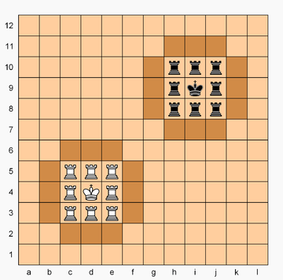
♜Chad: Game Overview
Played on a 12x12 gameboard with two 3x3 ‘castles’ .
Castles are surrounded on all four sides by ‘walls’
Each player has 8 rooks and one king which start in their own castle.
Rooks are promoted to queens if they enter their opponent's castle.
The king cannot leave its castle.
The king moves as a combination of the king and knight in normal chess.
A player wins by forcing a checkmate on the opponent's king.
Notes:
Josh

Slide 3
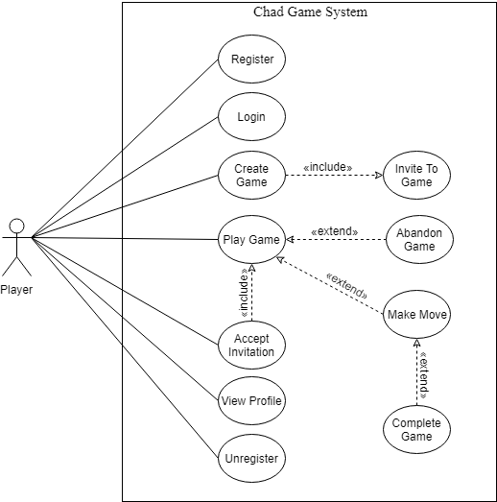
♜Use Cases
Notes:
Josh
Unchanged

Slide 4
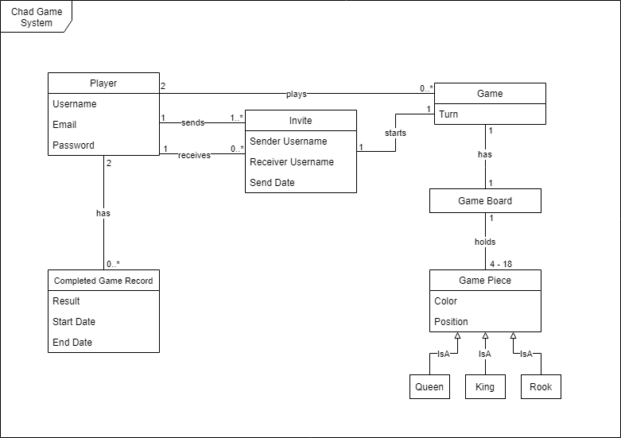
♜ Domain Model
Broke Use Cases into this
Domain Model
Invites essential
Defined key interactions
Notes:
Ben

Slide 5
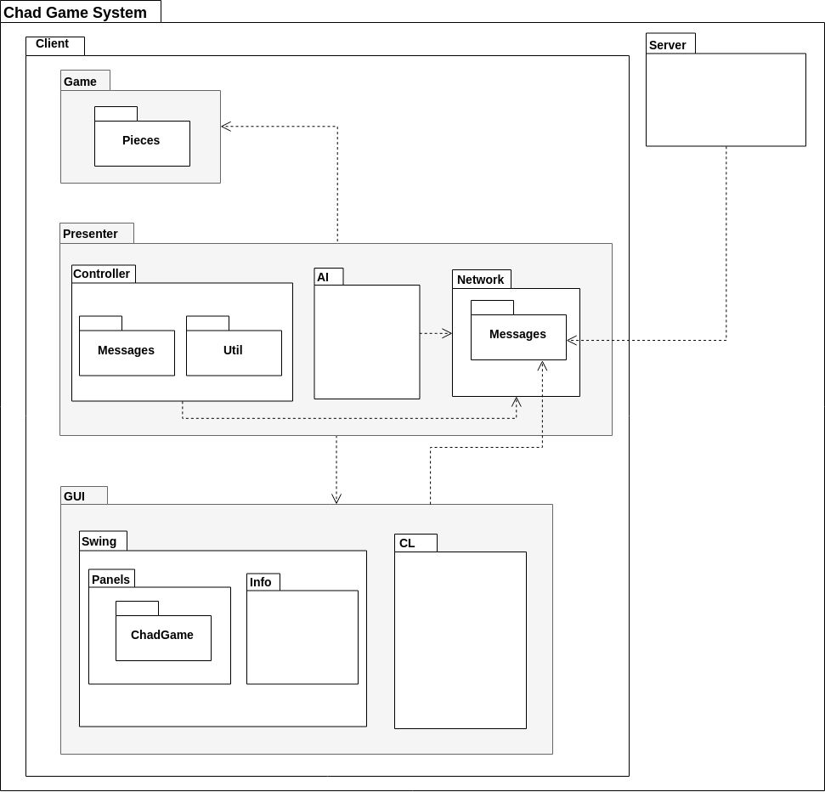
♜Package Diagram
Primary packages in Model-View-Presenter
Client-Server for login, game tracking, game history and asynchronous games
Notes:
Ben

Slide 6
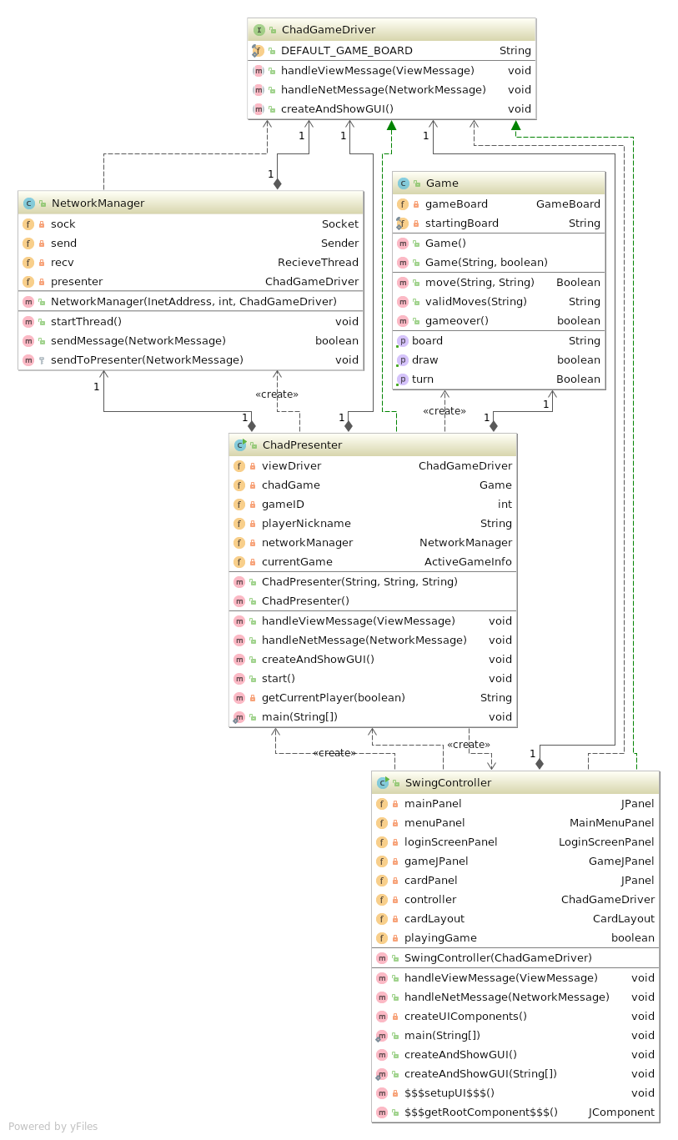
♜Class Diagram
Primary Classes of the Model-View-Presenter
Full Class Diagram in our Design Document much too large to show on slides
Notes:
Joshiah

Slide 7
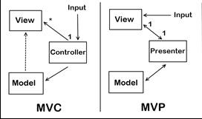
♜Source: Design Patterns
Main Architecture: Model View Presenter
GUI Chad Piece Factory
GUI Drivers strong compositions
Game Model is a Facade
Template Method for Game Pieces
Client-Server Architecture for Networking
Notes:
Ben

Slide 8
♜Technology
Swing GUI
MySQL DB
Maven Build
Travis CI
Code Climate
Notes:
Ben

Slide 9

♜Testing
Unit Testing
Tests at every class
System Testing
Server and Network interactions
Play testing
AI testing
Notes:
Luis

Slide 10
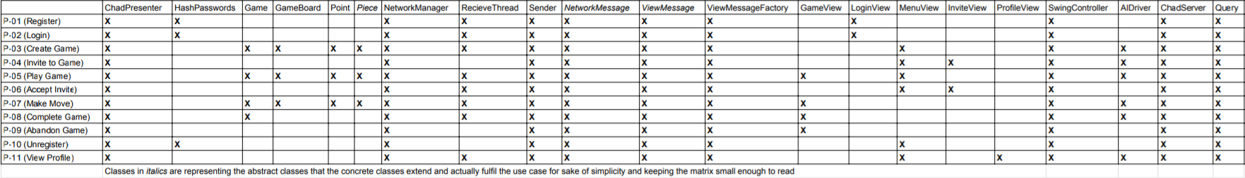
♜Traceability Link Matrix
Notes:
Luis
Views are interfaces
Not complete TLM

Slide 11
♜Challenges
Defining the database tables and columns
As we continued development we had to add additional columns and expand varchar ranges to fit the whole system as it evolved.
Communicating about implementation of MVP
For each message some knowledge of the logic for other components was needed to send the appropriate information.
Integrating Java and Python together for the AI Agent
The AI was trained through Python and querying the neural net for AI Agent moves required a Python call.
Notes:
Miles

Slide 12
♜Lessons Learned
Pick NIO or IO for networking interactions, not both.
Picking one package from the start would have made the networking part of the system more coherent and easier to maintain
Messages to the Viewer should have been created alongside new features in the GUI/CLI
Each message should have been added to the system when a new feature was created instead of creating them all as a whole in the beginning.
Notes:
Josiah

Slide 13
Demonstration
Notes:
All

Slide 14
Questions?
Notes:
All

